Slide 1

UNIVERSITY INSTITUTE OF ENGINEERING
COMPUTER SCIENCE ENGINEERING
Bachelor of Engineering (Computer Science & Engineering)
Subject Name: STATISTICAL METHODS USING R
Subject Code: 20SMT-460
Continuous distributions
Mapped with CO
Prepared By:
Ms. Hardeep Kaur
DISCOVER . LEARN . EMPOWER

Slide 2
Normal Distribution
The normal distribution was first discovered in1733 by English mathematician De-Moivre, who obtained this continuous distribution as a limiting case of the binomial distribution and applied it to problems arising in the game of chance. It was also known to Laplace, no later than 1774 but through a historical error it was credited to Gauss, who first made reference to it in the beginning of 19th century (1809), as the distribution of errors in Astronomy.
Gauss used the normal curve to describe the theory of accidental errors of measurements involved in the calculation of orbits of heavenly bodies. Throughout the eighteenth and nineteenth centuries, various efforts were made to establish the normal model as the underlying law ruling all continuous random variables. Thus, the name "normaI" . These efforts. however. failed because of false premises. The normal model has, nevertheless become the most important probability model in statistical analysis.

Slide 3
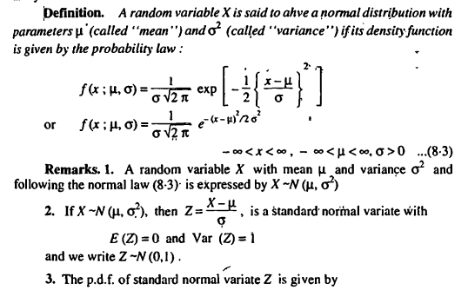
Normal Distribution

Slide 4
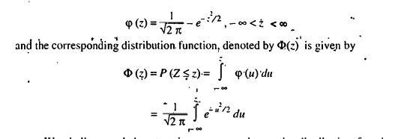

Slide 5
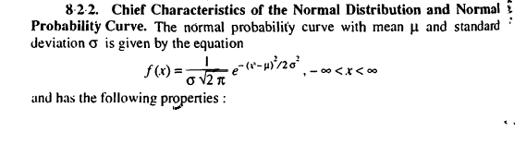
Properties of Normal Distribution

Slide 6
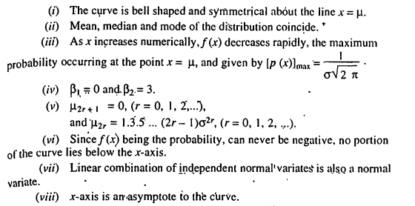

Slide 7
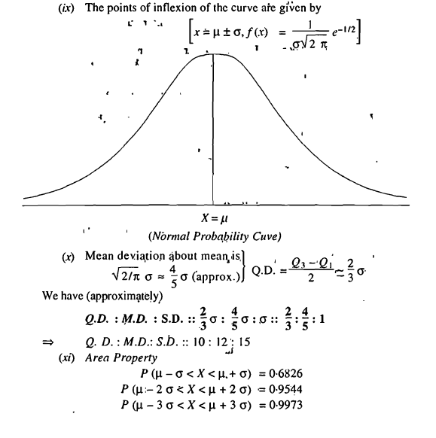

Slide 8
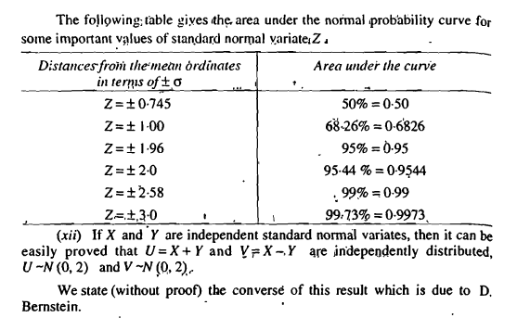
Area under the Normal Curve

Slide 9
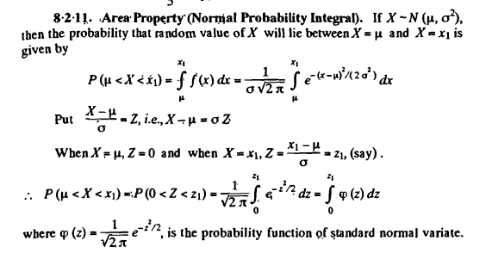

Slide 10
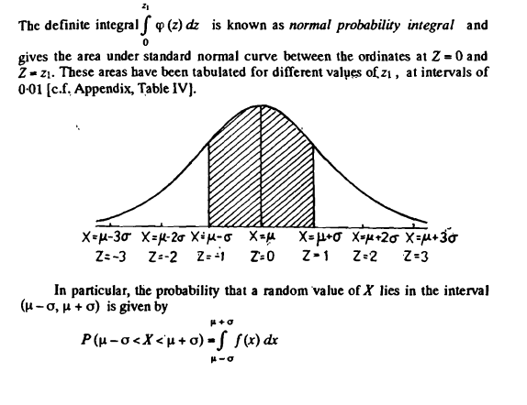

Slide 11
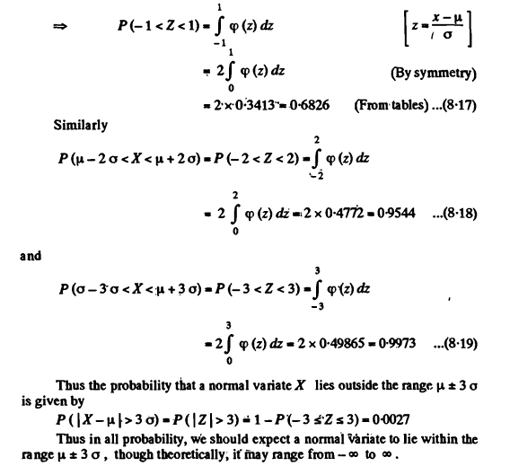

Slide 12
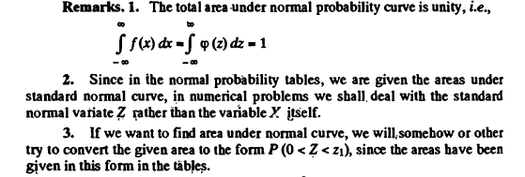
Remarks

Slide 13
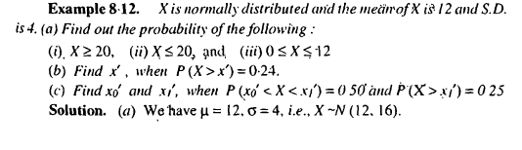
Examples

Slide 14
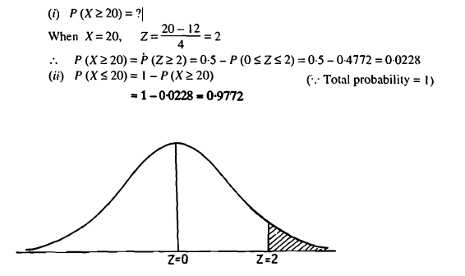

Slide 15
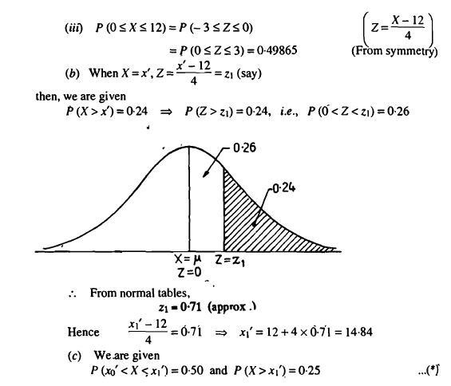

Slide 16
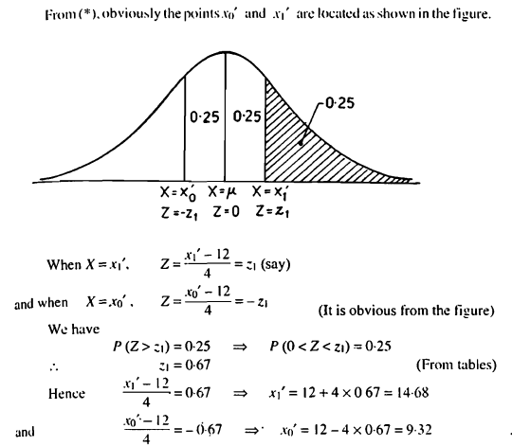

Slide 17
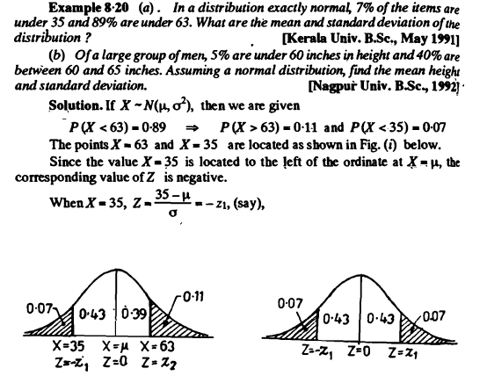

Slide 18
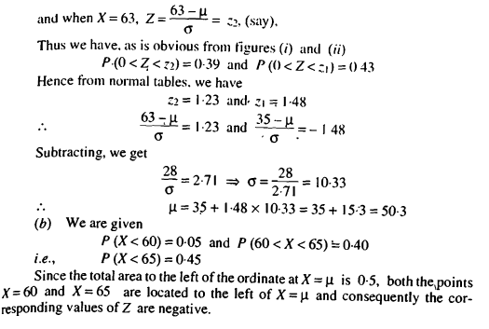

Slide 19
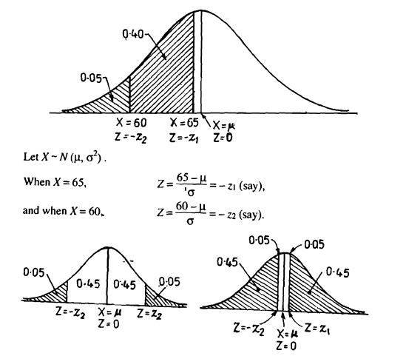

Slide 20
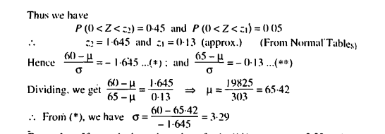

Slide 21
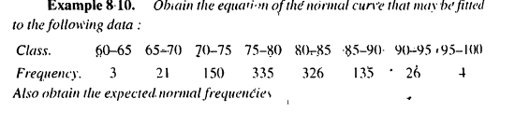

Slide 22
